Slide 1

Data Analysis with
2. SparkSQL &
DataFrames

Slide 2
RDDs: Pros and Cons
Pros:
Developers: low level control of execution
Cons:
For user:
  complicated to express complex ideas
  difficult to understand the code
For Spark: lambda functions are opaque (no optimization)
Data Analysis with Spark - 1. Introduction & RDDs

Slide 3
DataFrames
Structured dataset:
  In-memory, distributed tables
  Named and typed columns: schema
  Collection of Rows
Sources available: structured files, Hive tables, RDBMS (MySQL, PostgreSQL, …), RDDs
High-level APIs
Data Analysis with Spark - 2. SparkSQL & DataFrames

Slide 4
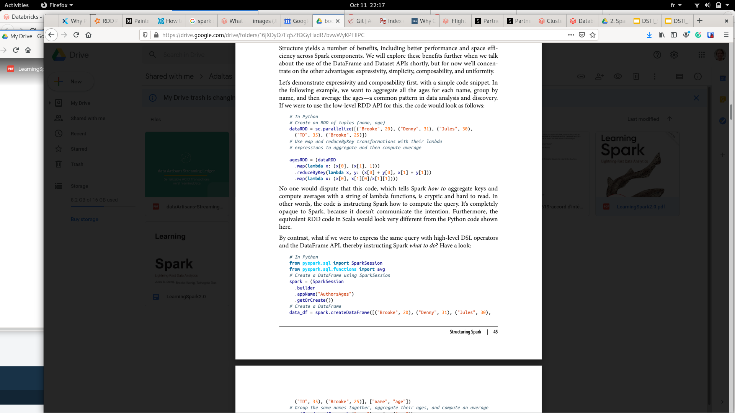
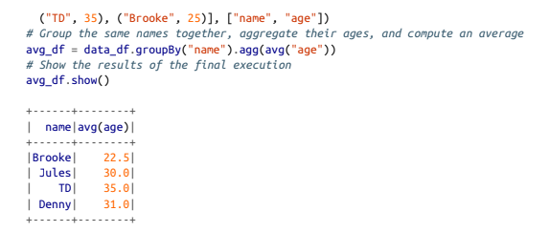
RDDs vs DataFrames: code
What to do?
How to do it?
Data Analysis with Spark - 1. Introduction & RDDs

Slide 5
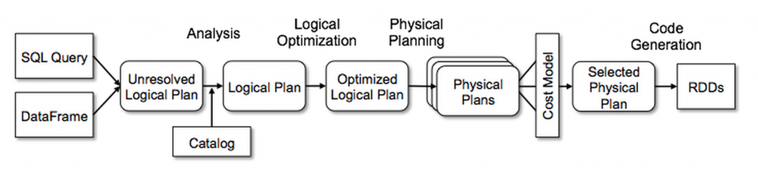
Catalyst Optimizer
someRdd
.reduceByKey(lambda x, y: ...)
.filter(lambda x: ...)
someDF
.groupBy(“...”)
.filter(cond)
Data Analysis with Spark - 1. Introduction & RDDs

Slide 6
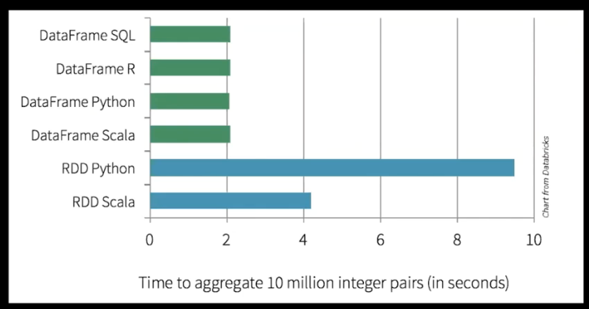
Catalyst Optimizer
Data Analysis with Spark - 1. Introduction & RDDs

Slide 7
Working with DataFrames
Querying DataFrames:
By chaining functions:
df
.select(...)
.filter(...)
By writing SQL strings:
spark.sql("SELECT * FROM table")
Data Analysis with Spark - 2. SparkSQL & DataFrames

Slide 8
Why SQL?
Around since the 70s
Huge enterprise usage:
  Lots of users
  Lots of projects
But: cannot be used for ML or graph analyses
Data Analysis with Spark - 2. SparkSQL & DataFrames

